Slide 1
Contents
Software Testing – 1. Principles
Why testing is necessary
Fundamental test process
Psychology of testing
Software Testing - Principles

Slide 2
What is testing ?
Trying to Fix it !
Trying to Break it !
“When we are testing something we are checking whether it is OK”
Software Testing - Principles

Slide 3
Reliability versus faults
Reliability: the probability that software will not cause the failure of the system for a specified time under specified conditions
If we test software and find few “bugs”, is this good software ?
Software Testing - Principles

Slide 4
Why do faults occur in software?
software is written by human beings
  who know something, but not everything
  who have skills, but aren’t perfect
  who do make mistakes (errors)
under increasing pressure to deliver to strict deadlines
  no time to check but assumptions may be wrong
  systems may be incomplete
if you have ever written software ...
Software Testing - Principles

Slide 5
What do software faults cost?
huge sums
  Ariane 5 ($7billion)
  Mariner space probe to Venus ($250m)
  American Airlines ($50m)
very little or nothing at all
  minor inconvenience
  no visible or physical detrimental impact
software is not “linear”:
  small input may have very large effect
Software Testing - Principles

Slide 6
Safety-critical systems
software faults can cause death or injury
  radiation treatment kills patients (Therac-25)
  train driver killed
  aircraft crashes (Airbus & Korean Airlines)
  bank system overdraft letters cause suicide
Software Testing - Principles

Slide 7
So why is testing necessary?
  because software is likely to have faults
  to learn about the reliability of the software
  because failures can be very expensive
  to avoid being sued by customers
  to stay in business
Not Because
  to fill the time between delivery of the software and the release date
  to prove that the software has no faults
  because testing is included in the project plan
Software Testing - Principles

Slide 8
Exhaustive testing?
What is exhaustive testing?
  when all the testers are exhausted
  when all the planned tests have been executed
  exercising all combinations of inputs and preconditions
How much time will exhaustive testing take?
  infinite time
  not much time
  impractical amount of time
Software Testing - Principles

Slide 9
How much testing is enough?
  it’s never enough
  when you have done what you planned
  when your customer/user is happy
  when you have proved that the system works correctly
  when you are confident that the system works correctly
  it depends on the risks for your system
Software Testing - Principles

Slide 10
How much testing?
It depends on RISK
  risk of missing important faults
  risk of incurring failure costs
  risk of releasing untested or under-tested software
  risk of losing credibility and market share
  risk of missing a market window
  risk of over-testing, ineffective testing
Software Testing - Principles

Slide 11
So little time, so much to test ..
test time will always be limited
use RISK to determine:
  what to test first
  what to test most
  how thoroughly to test each item
}
i.e. where to
place emphasis
  what not to test (this time)
use RISK to
  allocate the time available for testing by prioritising testing ...
Software Testing - Principles

Slide 12
Most important principle
Prioritise tests
so that,
whenever you stop testing,
you have done the best testing
in the time available.
Software Testing - Principles

Slide 13
Testing and quality
What is quality ?
“If the customer wants a cheap car for a ‘run-about’ and
has a small budget then an expensive sports car is not
a quality solution, however well built it is. “
Software Testing - Principles

Slide 14
Testing and quality
Bottom Line
A customer whats the right software system
built correctly, within budget and timescale.
Software Testing - Principles

Slide 15
Testing and quality
what does testing test?
  system function, correctness of operation
  non-functional qualities: reliability, usability, maintainability, reusability, testability, etc.
testing measures software quality
testing can find faults; when they are removed, software quality (and possibly reliability) is improved
Software Testing - Principles

Slide 16
Other factors that influence testing
contractual requirements
legal requirements
industry-specific requirements
  e.g. pharmaceutical industry (FDA), compiler standard tests, safety-critical or safety-related such as railroad switching, air traffic control
It is difficult to determine
how much testing is enough
but it is not impossible
Software Testing - Principles

Slide 17
What is testing ?
The driving test – an analogy for software testing.
Software Testing - Principles

Slide 18
What is testing ?
* Planning – Plan what we want to do
* Preparation – What testing will we do
*Test execution – implement the tests (follow the plan)
* Evaluation – compare actual with expected
* Closure – Can we stop
Software Testing - Principles

Slide 19
What is testing ?
The process consisting of all life cycle activities,
both static and dynamic, concerned with planning,
preparation and evaluation of software products to
determine that they satisfy specified requirements,
to demonstrate that they are fit for purpose and
to detect defects.
Software Testing - Principles

Slide 20
Testing Principles.
These principles have been suggested over the past
40 years and offer general guidelines common for all testing.
See Handout.
Software Testing - Principles

Slide 21
Software Testing – 1. Principles
Contents
Why testing is necessary
Fundamental test process
Psychology of testing
Software Testing - Principles

Slide 22
Fundamental test process
Planning and control
Analysis and Design
Implementation and Execution
Evaluating exit criteria and reporting
Test Closure activities
Software Testing - Principles

Slide 23
Most important principle
Prioritise tests
so that,
whenever you stop testing,
you have done the best testing
in the time available.
Software Testing - Principles

Slide 24
Test planning in a nut shell
how the test strategy and project test plan apply to the software under test
document any exceptions to the test strategy
Determine the scope and risks and identify the objectives of testing.
Determine the test approach
Determine the required resources
Schedule the design, execution and evaluation
set test completion criteria
Software Testing - Principles

Slide 25
Test Design
test specification can be broken down into three distinct tasks:
  1. identify: determine ‘what’ is to be tested (identify
  test conditions) and prioritise
  2. design: determine ‘how’ the ‘what’ is to be tested
  (i.e. design test cases)
  3. build: implement the tests (data, scripts, etc.)
Software Testing - Principles

Slide 26
Task 1: identify conditions
(determine ‘what’ is to be tested and prioritise)
list the conditions that we would like to test:
  use the test design techniques specified in the test plan
  there may be many conditions for each system function or attribute
  e.g.
    Use of indicators
    Behaviour at junctions
prioritise the test conditions
  must ensure most important conditions are covered
Software Testing - Principles

Slide 27
Task 2: design test cases
(determine ‘how’ the ‘what’ is to be tested)
design test input and test data
  each test exercises one or more test conditions
  (Include T junctions, crossroads etc)
determine expected results
  predict the outcome of each test case, what is output, what is changed and what is not changed
design sets of tests
  different test sets for different objectives such as regression, building confidence, and finding faults
Software Testing - Principles

Slide 28
Task 3: build test cases
(implement the test cases)
prepare test scripts
  less system knowledge tester has the more detailed the scripts will have to be
  scripts for tools have to specify every detail
prepare test data
  data that must exist in files and databases at the start of the tests
prepare expected results
  should be defined before the test is executed
Software Testing - Principles

Slide 29
A good test case
Finds faults
effective
exemplary
evolvable
economic
Represents others
Easy to maintain
Cheap to use
Software Testing - Principles

Slide 30
Execution
Execute prescribed test cases
  most important ones first
  would not execute all test cases if
    testing only fault fixes
    too many faults found by early test cases
    time pressure
  can be performed manually or automated
Software Testing - Principles

Slide 31
Test recording 1
The test record contains:
  identities and versions (unambiguously) of
    software under test
    test specifications
Follow the plan
  mark off progress on test script
  document actual outcomes from the test
  capture any other ideas you have for new test cases
  note that these records are used to establish that all test activities have been carried out as specified
Software Testing - Principles

Slide 32
Test recording 2
Compare actual outcome with expected outcome. Log discrepancies accordingly:
  software fault
  test fault (e.g. expected results wrong)
  environment or version fault
  test run incorrectly
Log coverage levels achieved (for measures specified as test completion criteria)
After the fault has been fixed, repeat the required test activities (execute, design, plan)
Software Testing - Principles

Slide 33
Check test completion
Test completion criteria were specified in the test plan
If not met, need to repeat test activities, e.g. test specification to design more tests
Coverage too low
Design
execution
recording
check
completion
Coverage
OK
Software Testing - Principles

Slide 34
Test completion criteria
Completion or exit criteria apply to all levels of testing - to determine when to stop
  coverage, using a measurement technique, e.g.
    branch coverage for unit testing
    user requirements
    most frequently used transactions
  faults found (e.g. versus expected)
  cost or time
Software Testing - Principles

Slide 35
Software Testing – 1. Principles
Contents
Why testing is necessary
Fundamental test process
Psychology of testing
Software Testing - Principles

Slide 36
What is testing ?
Trying to Fix it !
Trying to Break it !
“When we are testing something we are checking whether it is OK”
Software Testing - Principles

Slide 37
Confidence
Confidence
Fault found
Faults found
Time
No faults found = confidence?
Software Testing - Principles

Slide 38
Assessing software quality
You think
you are here
High
Few
Faults
Many
Faults
Few
Faults
Low
High
Software Quality
Few
Faults
Test
Quality
Few
Faults
You may
be here
Software Testing - Principles
Low

Slide 39
The testing paradox
Purpose of testing: to find faults
Purpose of testing: destroy confidence
Finding faults destroys confidence
Purpose of testing: build confidence
The best way to build confidence
is to try to destroy it
Software Testing - Principles

Slide 40
Who wants to be a tester?
A destructive process
Bring bad news (“your baby is ugly”)
Under worst time pressure (at the end)
Need to take a different view, a different mindset (“What if it isn’t?”, “What could go wrong?”)
How should fault information be communicated (to authors and managers?)
Software Testing - Principles

Slide 41
Tester’s have the right to:
  accurate information about progress and changes
  insight from developers about areas of the software
  delivered code tested to an agreed standard
  be regarded as a professional (no abuse!)
  find faults!
  challenge specifications and test plans
  have reported faults taken seriously (unreproducible)
  make predictions about future fault levels
  improve your own testing process
Software Testing - Principles

Slide 42
Testers have responsibility to:
  follow the test plans, scripts etc. as documented
  report faults objectively and factually (no abuse!)
  check tests are correct before reporting s/w faults
  remember it is the software, not the programmer, that you are testing
  assess risk objectively
  prioritise what you report
  communicate the truth
Software Testing - Principles

Slide 43
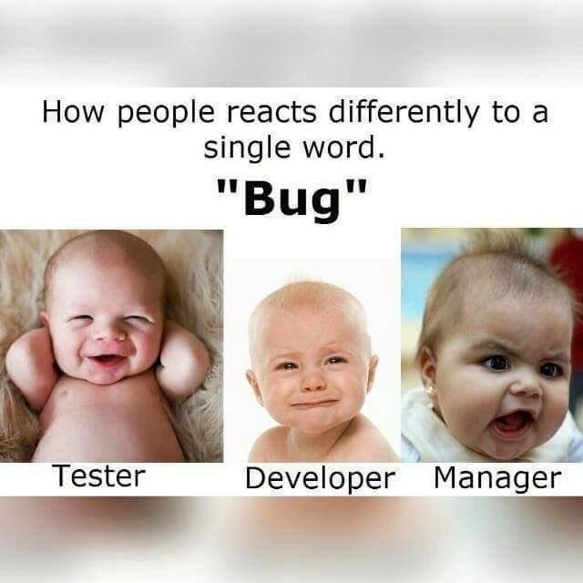
Software Testing - Principles

Slide 44
Independence
Test your own work?
  find 30% - 50% of your own faults
  same assumptions and thought processes
  see what you meant or want to see, not what is there
  emotional attachment
    don’t want to find faults
    actively want NOT to find faults
Software Testing - Principles

Slide 45
Levels of independence
None: tests designed by the person who wrote the software
Tests designed by a different person
Tests designed by someone from a different department or team (e.g. test team)
Tests designed by someone from a different organisation (e.g. agency)
Tests generated by a tool (low quality tests?)
Software Testing - Principles

Slide 46
Summary : Key Points
Testing is necessary because people make errors
The test process :
Planning,
Design,
Execution,
Evaluation,
Closure
Independence and relationships are important in testing.
Software Testing - Principles

